Slide 1



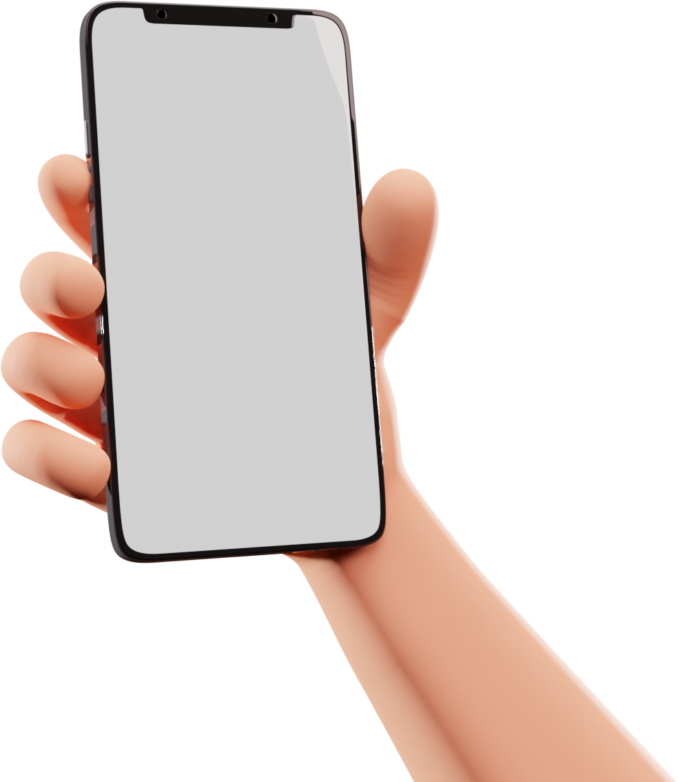
BORROW BOX
Presented by Heer and Fawaz

Slide 2

INTRODUCTION
The Borrow Box system is designed to facilitate seamless and efficient rental management for users and product owners. It enables users to rent, view, and manage products digitally while providing an organized and user-friendly platform for product owners to list and manage their inventory

Slide 3



MOTIVE
OF CHOOSNG
Reason of choosing this project is in daily life we have to purchase things for one time use and we waste money so it easy you life by providing a platform where you can rent an item or put item on rent earn money from your items and rent items which arent in daily life

Slide 4
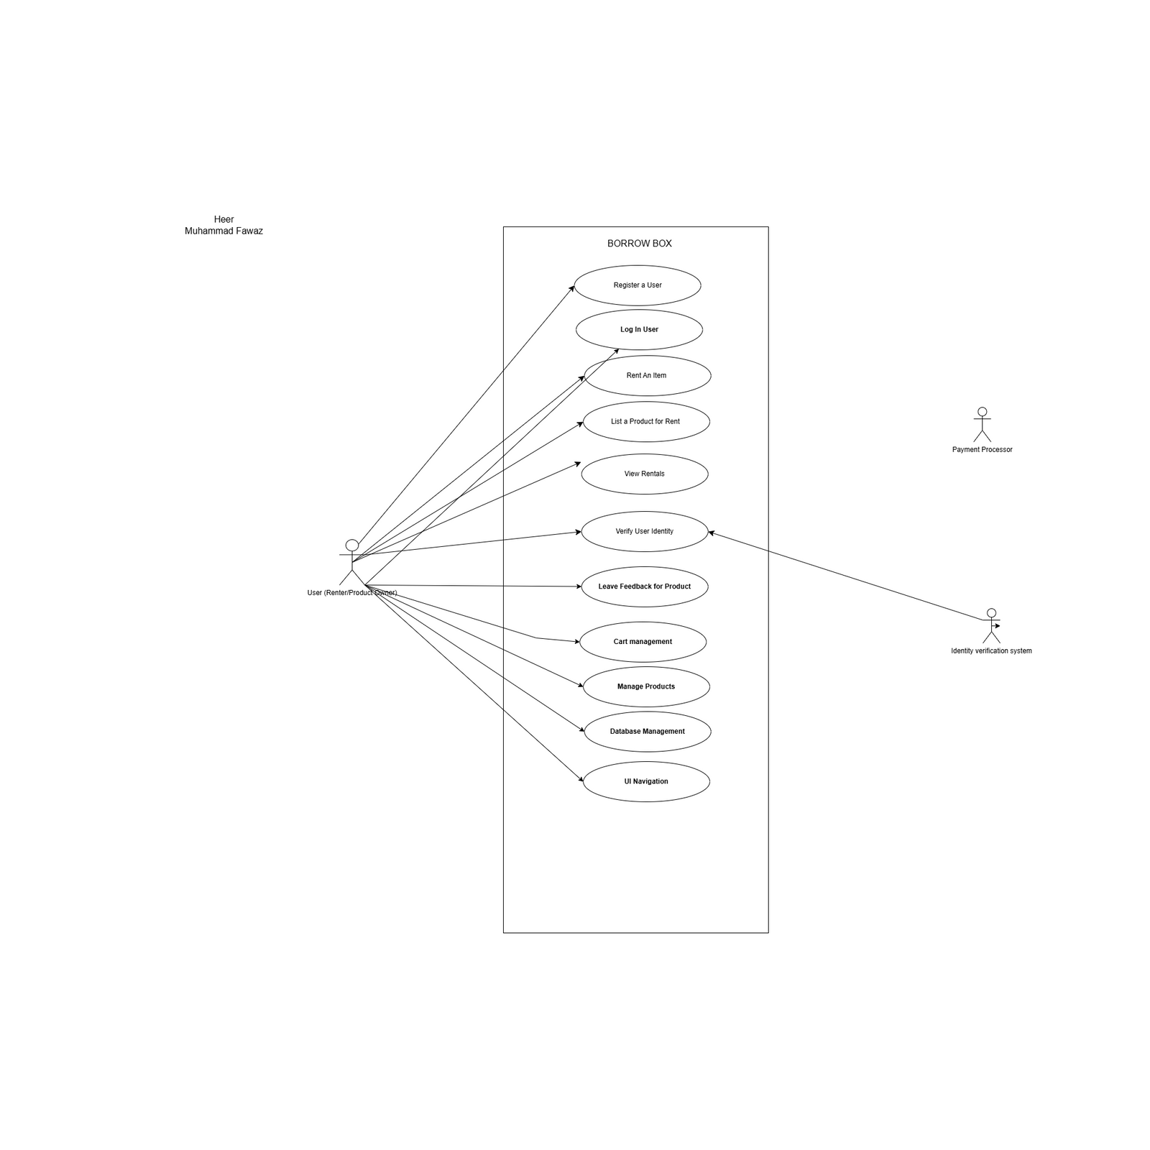
CLASS DAIGRAM

Slide 5
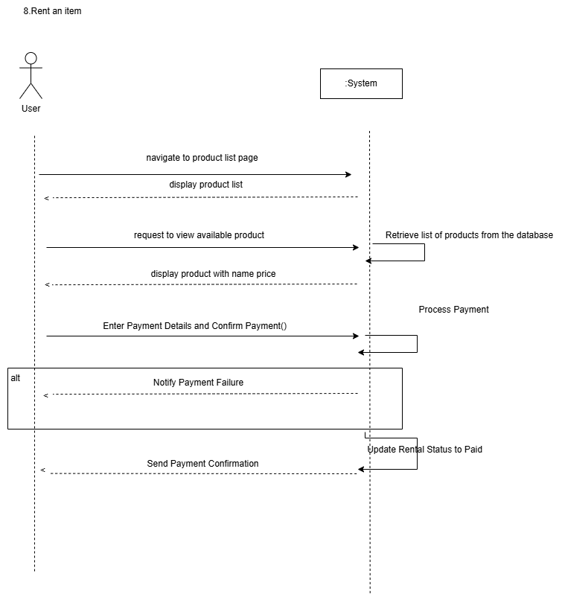
SYSTEM SEQUENCE DAIGRAM

Slide 6
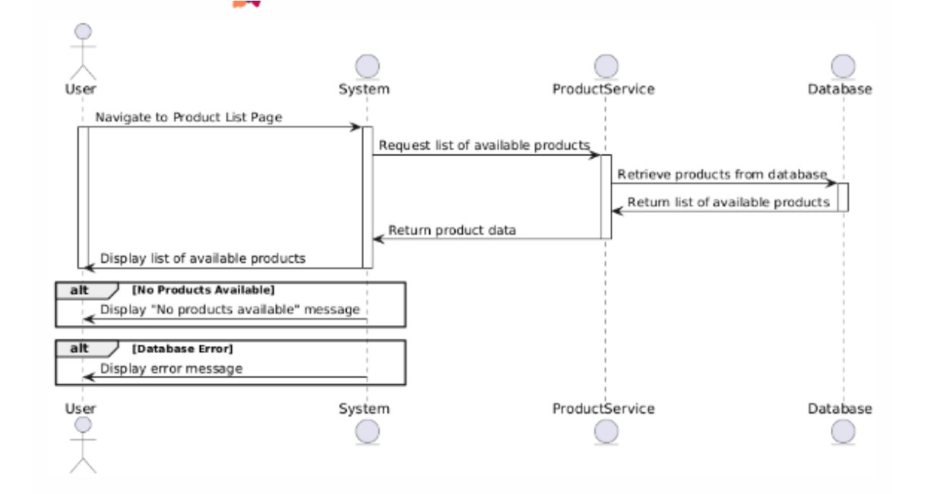
SEQUENCE DAIGRAM

Slide 7
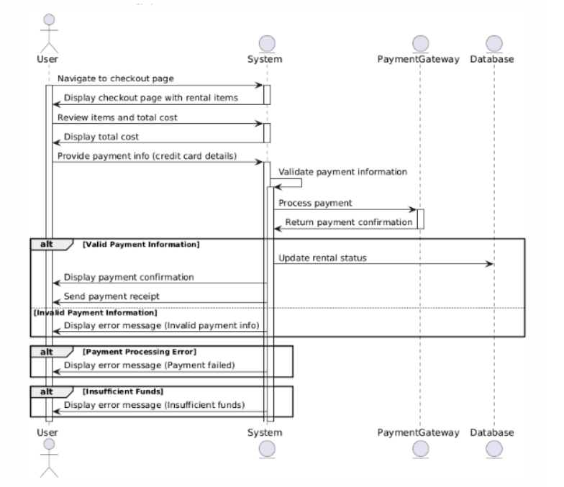

Slide 8
THANK YOU

